Slide 1
Limits, Derivatives, the Product Rule, the Quotient Rule, and the Chain Rule

Slide 2
Part I: Limits and Continuity
Objectives
- Know what left limits, right limits, and limits are.
- Know how to compute simple limits.
- Know what it means for a function to be continuous.

Slide 3
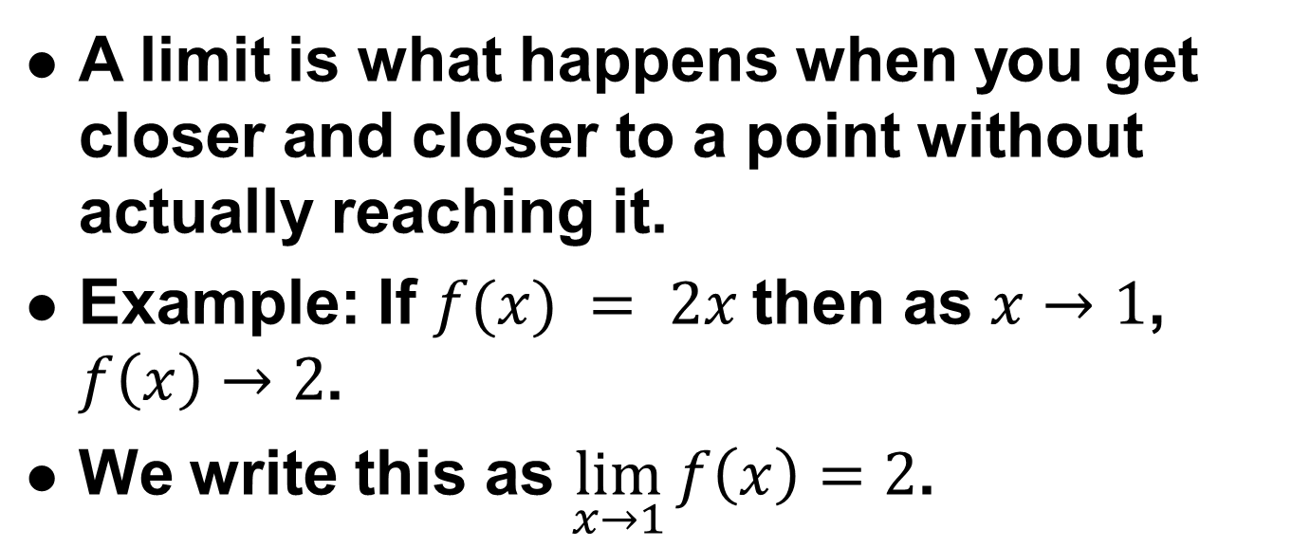
What is a limit?
A limit is what happens when you get closer and closer to a point without actually reaching it.
Example: If $f(x) = 2x$then as $x→1$, $f\left(x\right)→2$.
We write this as $\lim_{x→1}{f\left(x\right)=2}$.
x | 0 | .9 | .99 | .999 | .9999
f(x) | 0 | 1.8 | 1.98 | 1.998 | 1.9998

Slide 4
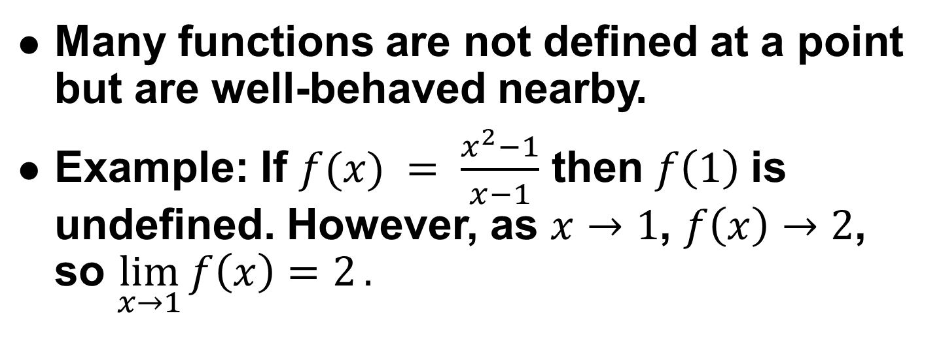
Why are limits useful?
Many functions are not defined at a point but are well-behaved nearby.
Example: If $f(x) = \frac{x^{2}−1}{x−1}$ then $f\left(1\right)$is undefined. However, as $x→1$, $f\left(x\right)→2$, so $\lim_{x→1}{f\left(x\right)=2}.$
4
3
2
1
f(x)
0
-1
x | 0 | .9 | .99 | .999 | .9999
f(x) | 0 | 1.9 | 1.99 | 1.999 | 1.999
-2
-3
-4
-4
-3
-2
-1
0
1
2
3
4
x

Slide 5
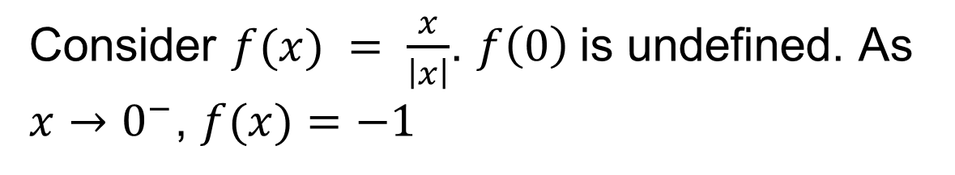
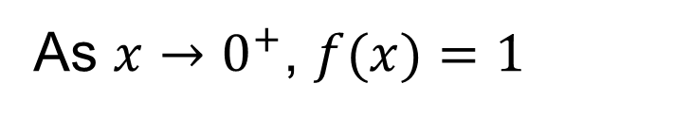
Left Limits and Right Limits
Consider $f(x) = \frac{x}{\left|x\right|}$. $f\left(0\right)$is undefined. As $x→0^{−}$, $f(x)=−1$
4
x | -1 | -.1 | -.01 | -.001 | -.0001
f(x) | -1 | -1 | -1 | -1 | -1
3
2
1
As $x→0^{+}$, $f(x)=1$
0
f(x)
-1
x | 1 | .1 | .01 | .001 | .0001
f(x) | 1 | 1 | 1 | 1 | 1
-2
-3
-4
-4
-3
-2
-1
0
1
2
3
4
x
We write this as $\lim_{x→0^{−}}{f\left(x\right)=−1},\lim_{x→0^{+}}{f(x)}{=1}$

Slide 6
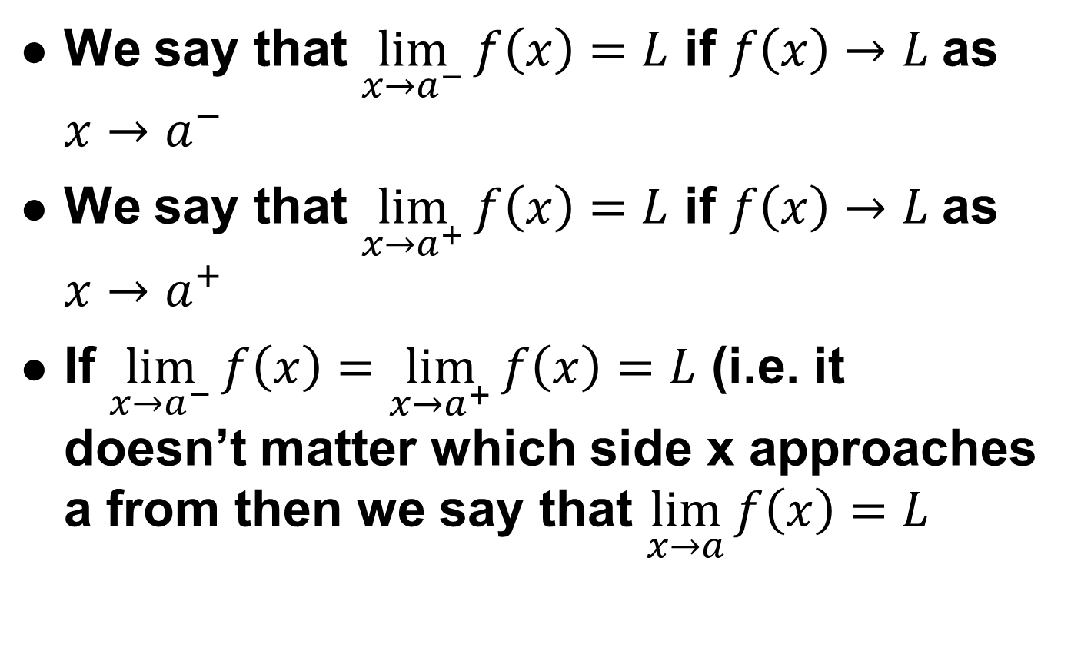
Limit Definition Summary
We say that $\lim_{x→a^{−}}{f\left(x\right)=L}$ if $f\left(x\right)→L$as $x→a^{−}$
We say that $\lim_{x→a^{+}}{f\left(x\right)=L}$ if $f\left(x\right)→L$as $x→a^{+}$
If $\lim_{x→a^{−}}{f\left(x\right)}=\lim_{x→a^{+}}{f\left(x\right)=L}$ (i.e. it doesn’t matter which side x approaches a from then we say that $\lim_{x→a}{f\left(x\right)=L}$

Slide 7
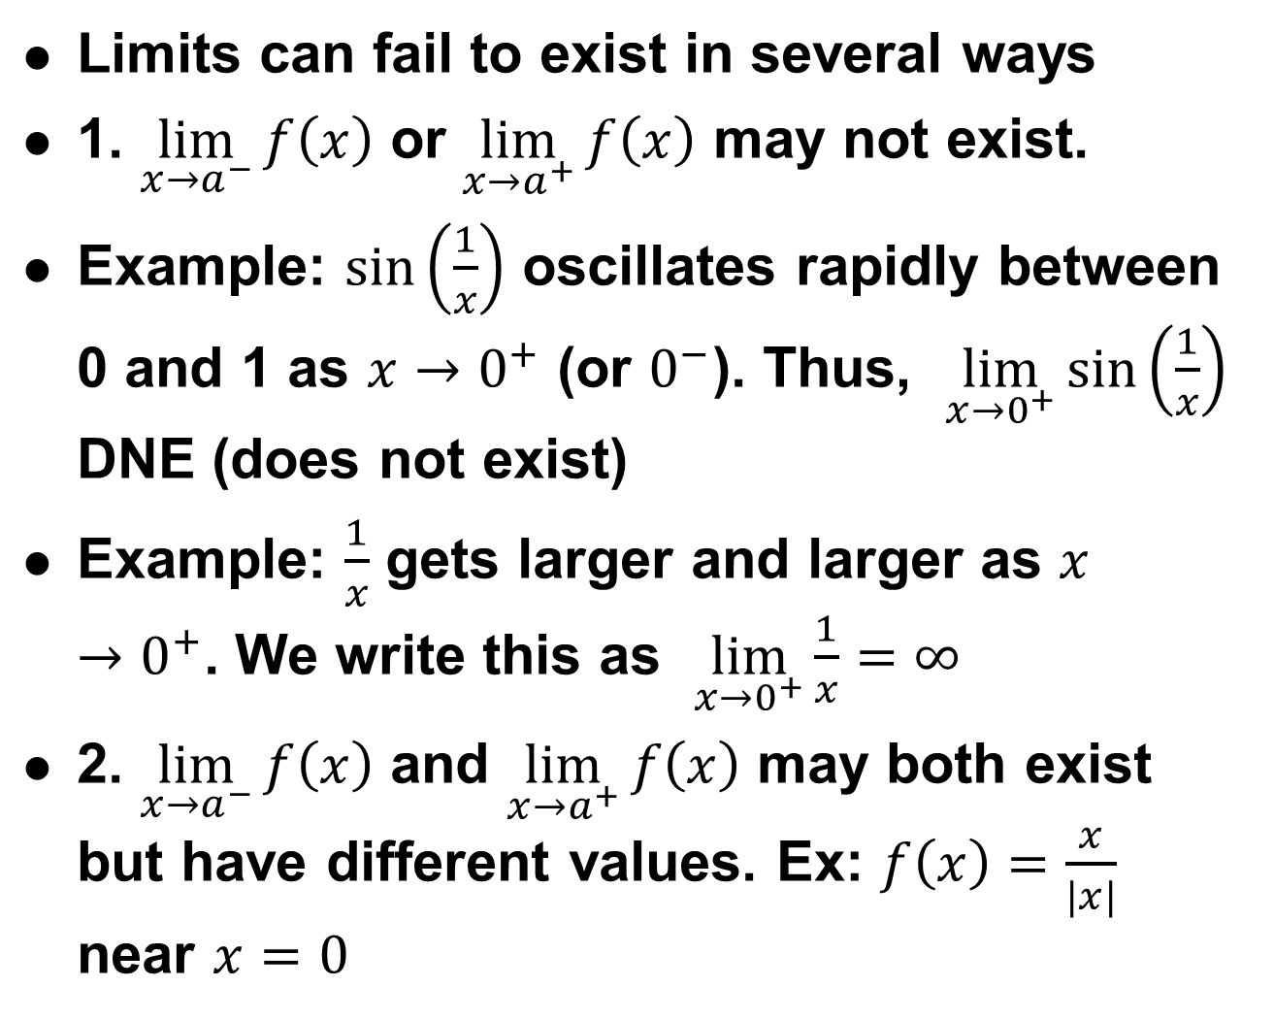
Nonexistence of Limits
Limits can fail to exist in several ways
1. $\lim_{x→a^{−}}{f\left(x\right)}$ or $\lim_{x→a^{+}}{f\left(x\right)}$ may not exist.
Example: $\sin\left(\frac{1}{x}\right)$ oscillates rapidly between 0 and 1 as $x→0^{+}$ (or $0^{−}$). Thus, $\lim_{x→0^{+}}{\sin\left(\frac{1}{x}\right)}$ DNE (does not exist)
Example: $\frac{1}{x}$ gets larger and larger as $x→0^{+}$. We write this as $\lim_{x→0^{+}}\frac{1}{x}=∞$
2. $\lim_{x→a^{−}}{f\left(x\right)}$ and $\lim_{x→a^{+}}{f\left(x\right)}$ may both exist but have different values. Ex: $f\left(x\right)=\frac{x}{|x|}$ near $x=0$

Slide 8
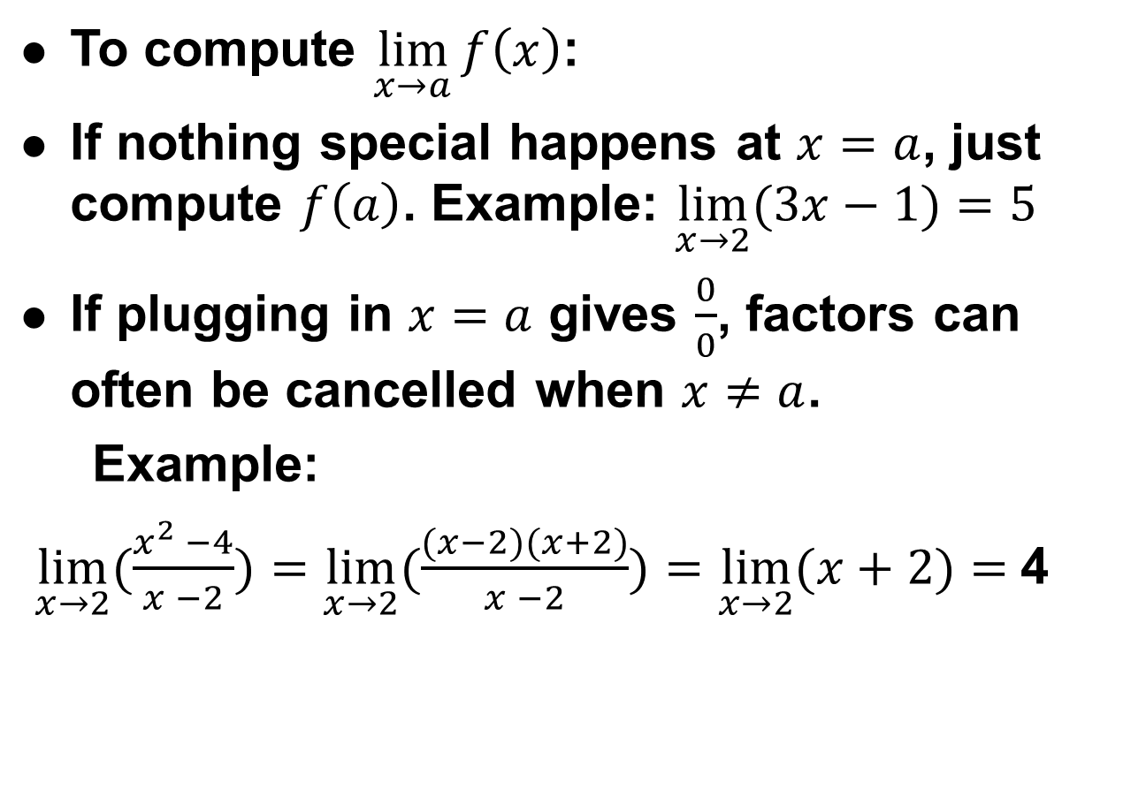
Computing Limits
To compute $\lim_{x→a}{f\left(x\right)}$:
If nothing special happens at $x=a$, just compute $f\left(a\right)$. Example: $\lim_{x→2}{(3x−1})=5$
If plugging in $x=a$ gives $\frac{0}{0}$, factors can often be cancelled when $x≠a$.
Example:
$\lim_{x→2}{(\frac{x^{2} −4}{x −2}})=\lim_{x→2}{(\frac{(x−2)(x+2)}{x −2}})=\lim_{x→2}{(x+2})=$4

Slide 9
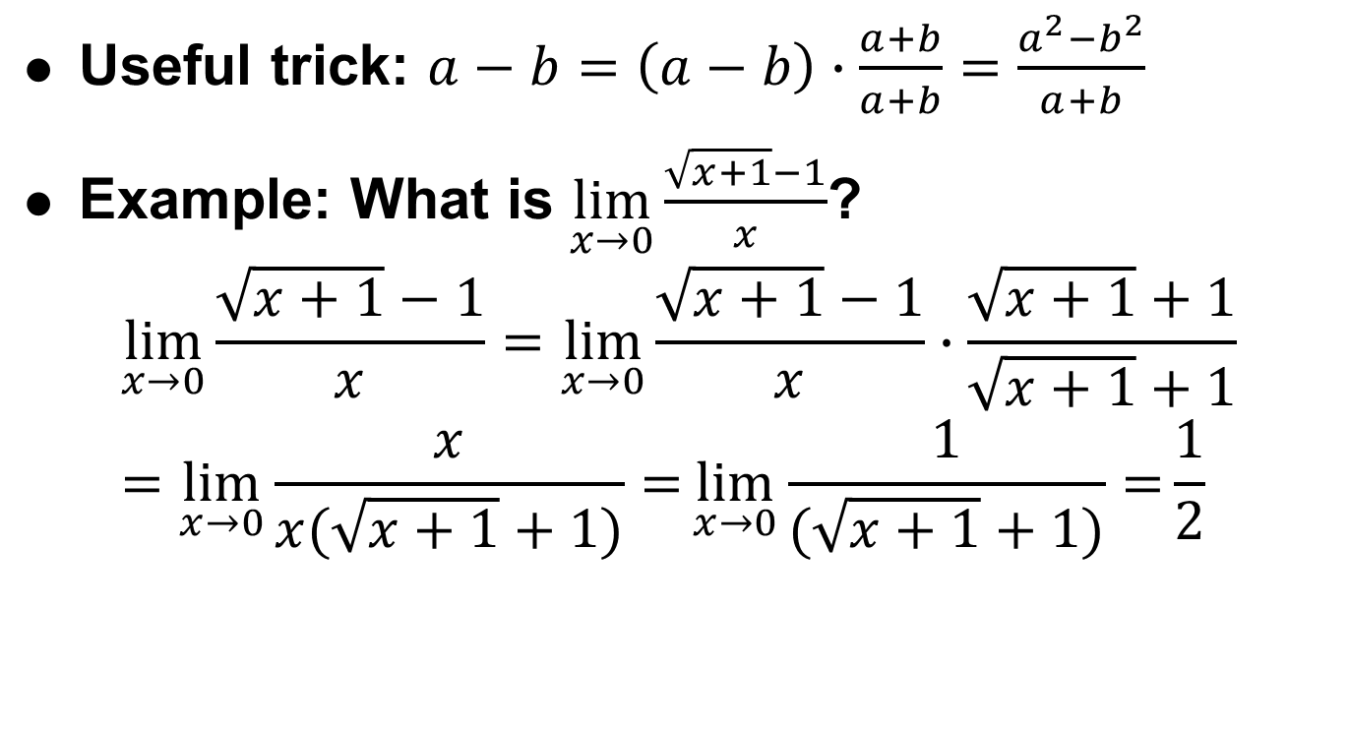
Computing Limits Continued
Useful trick: $a−b=\left(a−b\right)∙\frac{a+b}{a+b}=\frac{a^{2}−b^{2}}{a+b}$
Example: What is $\lim_{x→0}{\frac{\sqrt{x+1}−1}{x}}$?
$$\lim_{x→0}{\frac{\sqrt{x+1}−1}{x}}=\lim_{x→0}{\frac{\sqrt{x+1}−1}{x}}∙\frac{\sqrt{x+1}+1}{\sqrt{x+1}+1}=\lim_{x→0}{\frac{x}{x(\sqrt{x+1}+1)}=}\lim_{x→0}{\frac{1}{(\sqrt{x+1}+1)}=}\frac{1}{2}$$

Slide 10
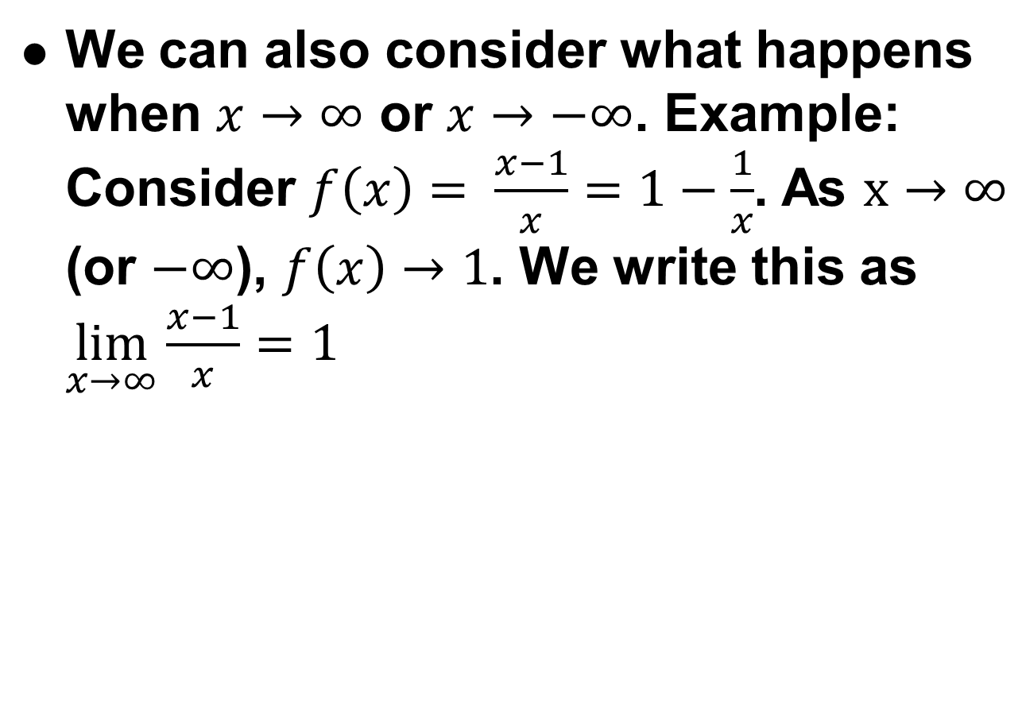
Limits at Infinity
We can also consider what happens when $x→∞$ or $x→−∞$. Example: Consider $f\left(x\right)= \frac{x−1}{x}=1−\frac{1}{x}$. As $x→∞$ (or $−∞$), $f\left(x\right)→1$. We write this as $\lim_{x→∞}{\frac{x−1}{x}}=1$

Slide 11
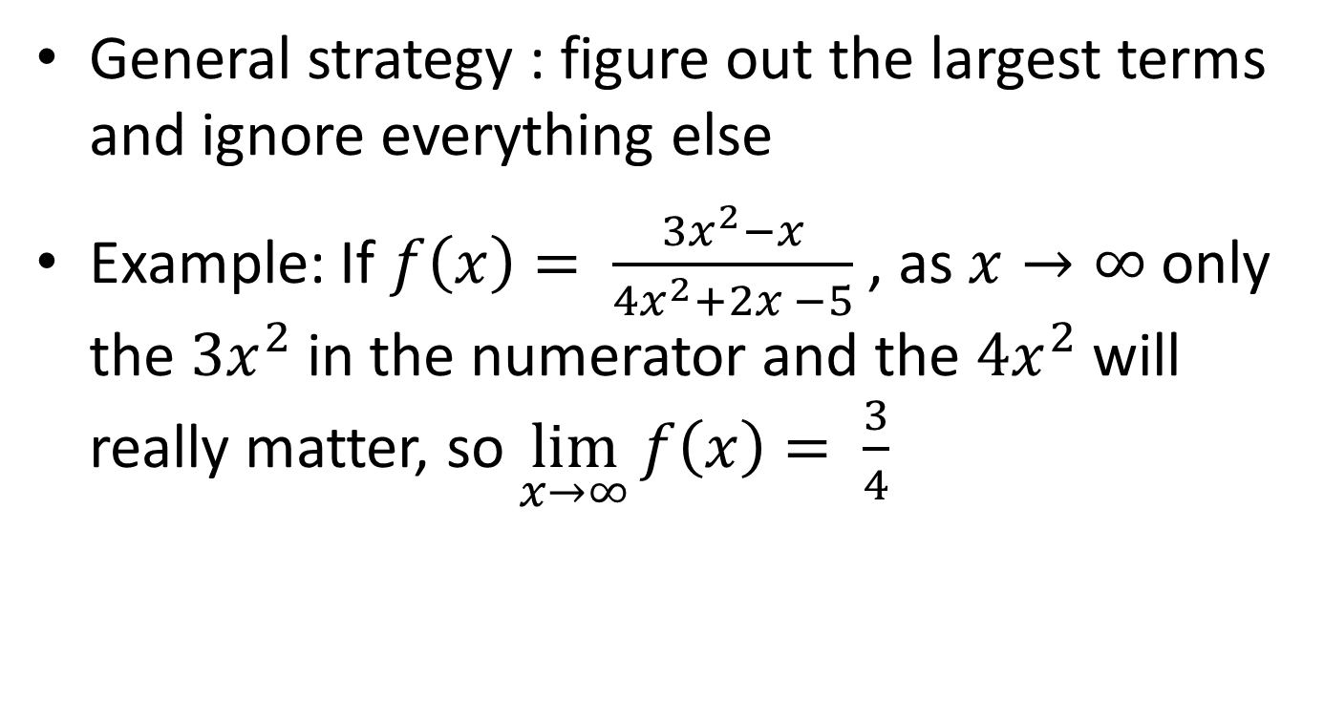

Computing Limits at $±∞$
General strategy : figure out the largest terms and ignore everything else
Example: If $f\left(x\right)= \frac{3x^{2}−x}{4x^{2}+2x −5}$ , as $x→∞$ only the $3x^{2}$ in the numerator and the $4x^{2}$ will really matter, so $\lim_{x→∞}{f\left(x\right)= \frac{3}{4}}$

Slide 12
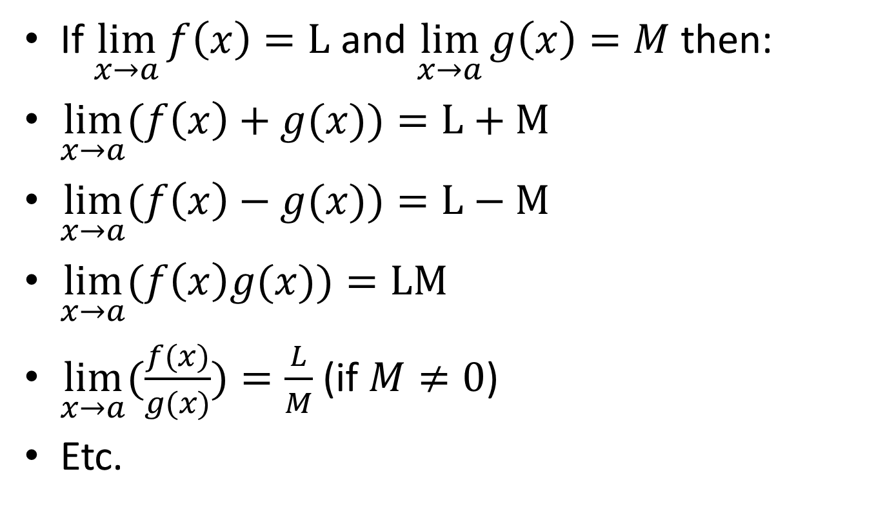
Limit Laws
If $\lim_{x→a}{f\left(x\right)}=L$ and $\lim_{x→a}{g\left(x\right)}=M$ then:
$\lim_{x→a}{(f\left(x\right)+g(x))}=L+M$
$\lim_{x→a}{(f\left(x\right)−g(x))}=L−M$
$\lim_{x→a}{(f\left(x\right)g(x))}=LM$
$\lim_{x→a}{(\frac{f(x)}{g(x)})}=\frac{L}{M}$ (if $M≠0$)
Etc.

Slide 13
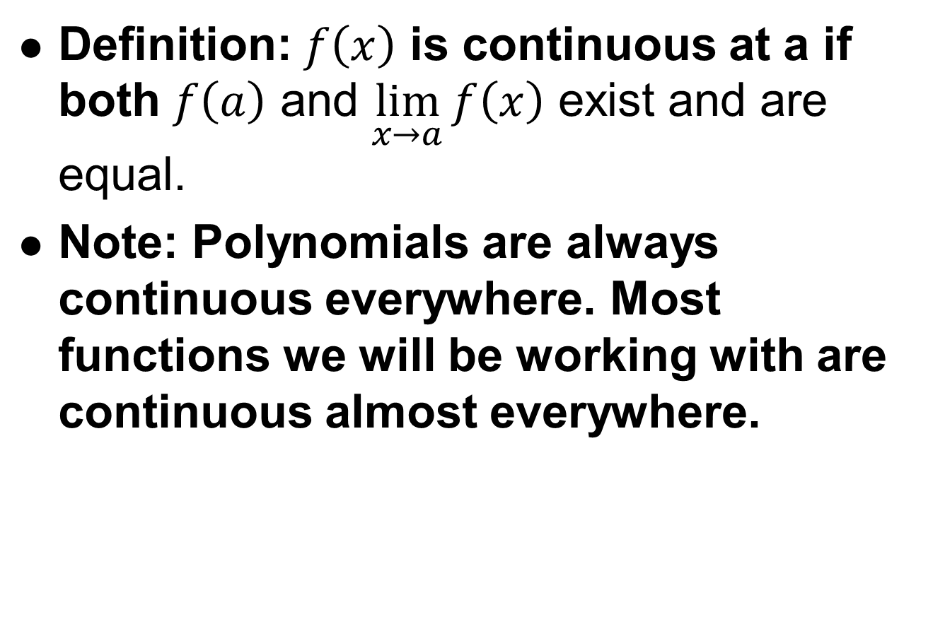
Continuity
Definition: $f\left(x\right)$ is continuous at a if both $f\left(a\right)$ and $\lim_{x→a}{f\left(x\right)}$ exist and are equal.
Note: Polynomials are always continuous everywhere. Most functions we will be working with are continuous almost everywhere.

Slide 14
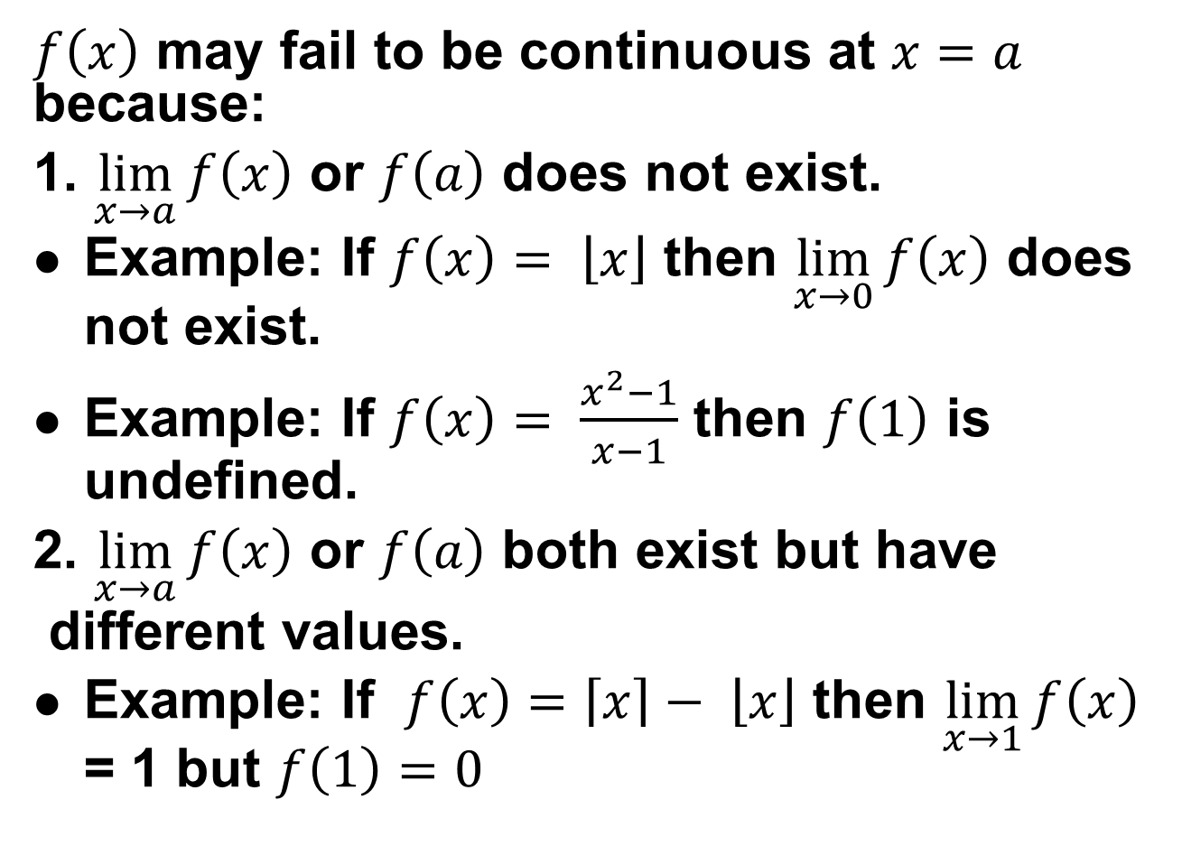
Discontinuous functions
$f\left(x\right)$ may fail to be continuous at $x=a$ because:
1. $\lim_{x→a}{f\left(x\right)}$ or $f\left(a\right)$ does not exist.
Example: If $f\left(x\right)= \left\lfloor x\right\rfloor$ then $\lim_{x→0}{f\left(x\right)}$ does not exist.
Example: If $f\left(x\right)= \frac{x^{2}−1}{x−1}$ then $f\left(1\right)$ is undefined.
2. $\lim_{x→a}{f\left(x\right)}$ or $f\left(a\right)$ both exist but have
different values.
Example: If $f\left(x\right)=\left\lceil x\right\rceil − \left\lfloor x\right\rfloor$ then $\lim_{x→1}{f\left(x\right)}$ = 1 but $f\left(1\right)=0$

Slide 15
Part II: Derivatives

Slide 16
Objectives:
Know what a derivative is
Know how to compute simple derivatives from the definition of a derivative
Know some basic facts about continuous and differentiable functions.

Slide 17
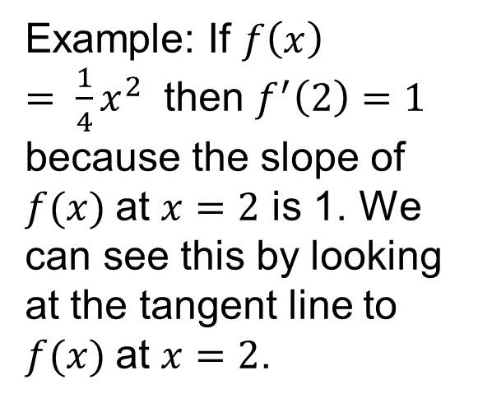
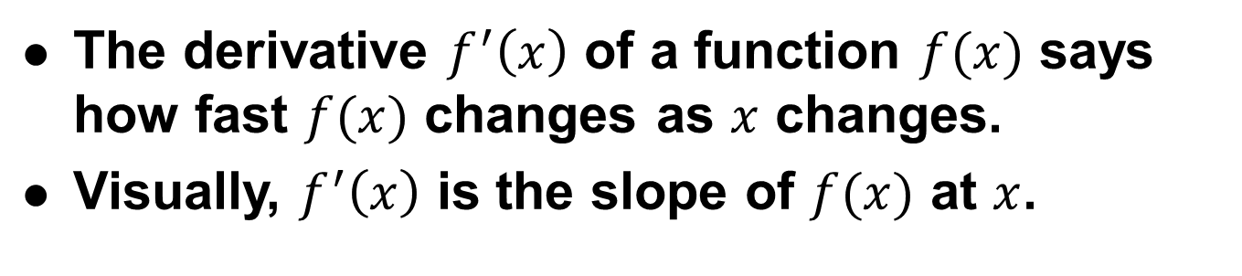
What is a derivative?
The derivative $f^{′}\left(x\right)$ of a function $f(x)$ says how fast $f(x)$ changes as $x$ changes.
Visually, $f^{′}\left(x\right)$ is the slope of $f(x)$ at $x$.
4
Example: If $f\left(x\right)= \frac{1}{4}x^{2}$ then $f^{′}\left(2\right)=1$ because the slope of $f(x)$at $x=2$ is 1. We can see this by looking at the tangent line to $f(x)$at $x=2$.
3
2
1
f(x)
0
-1
-2
-3
-4
-4
-3
-2
-1
0
1
2
3
4
x

Slide 18
Why are derivatives useful?
Tells us how quickly something is changing.
In physics: velocity is the derivative of position and acceleration is the derivative of velocity (with respect to time).
Optimization: Derivatives are crucial for finding the minimum or maximum of functions.
And much much more.

Slide 19

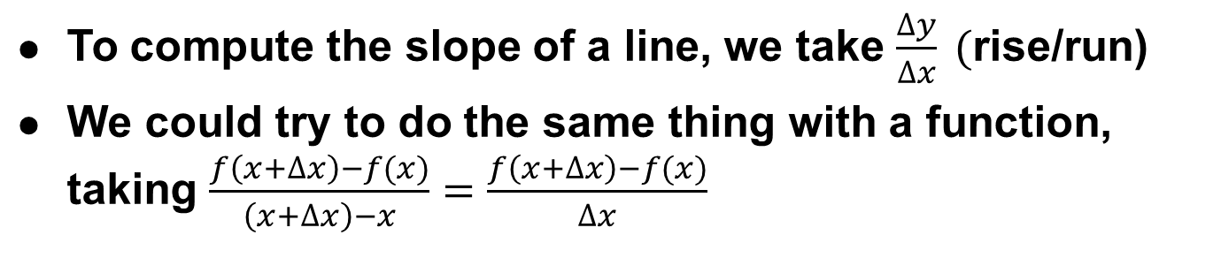
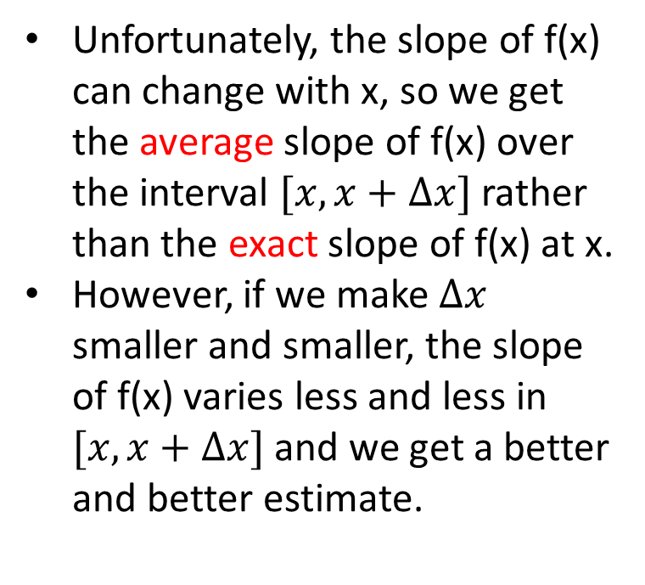
Computing derivatives
To compute the slope of a line, we take $\frac{∆y}{∆x} ($rise/run)
We could try to do the same thing with a function, taking $\frac{f\left(x+∆x\right)−f(x)}{\left(x+∆x\right)−x}=\frac{f\left(x+∆x\right)−f(x)}{∆x}$
$$f\left(x\right)=\frac{x^{3}}{16}$$
Unfortunately, the slope of f(x) can change with x, so we get the average slope of f(x) over the interval $[x,x+∆x]$ rather than the exact slope of f(x) at x.
However, if we make $∆x$ smaller and smaller, the slope of f(x) varies less and less in $[x,x+∆x]$ and we get a better and better estimate.
4
3
2
1
0
-1
-2
-3
-4
-4
-3
-2
-1
0
1
2
3
4
x

Slide 20
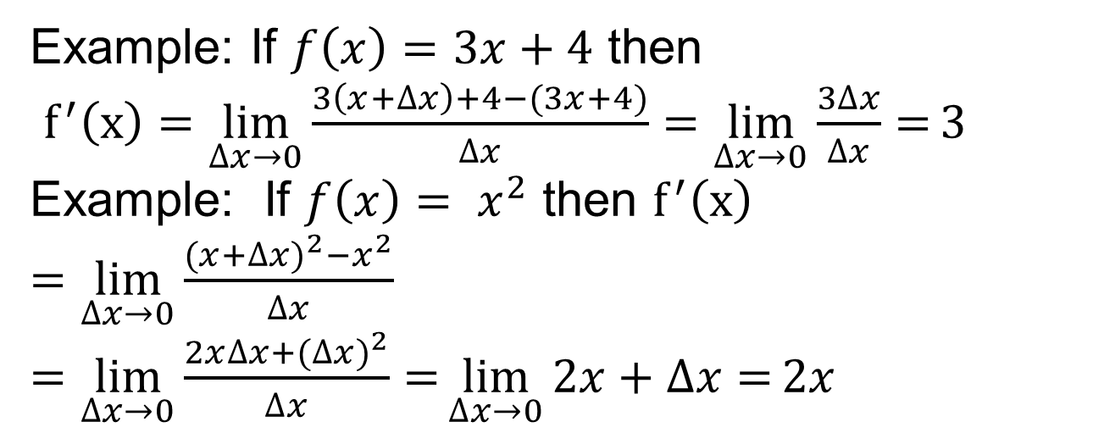
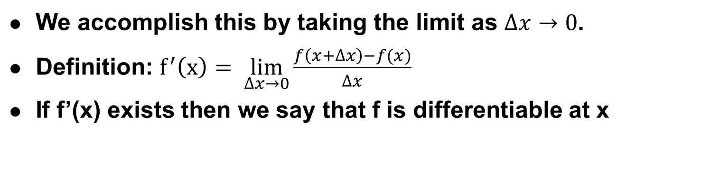
Derivative Definition and Examples
We accomplish this by taking the limit as $∆x→0$.
Definition: $f^{′}\left(x\right)= \lim_{∆x→0}{\frac{f\left(x+∆x\right)−f(x)}{∆x}}$
If f’(x) exists then we say that f is differentiable at x
Example: If $f\left(x\right)=3x+4$ then
$f^{′}\left(x\right)=\lim_{∆x→0}{\frac{3\left(x+∆x\right)+4−(3x+4)}{∆x}}=\lim_{∆x→0}{\frac{3∆x}{∆x}=}3$
Example: If $f\left(x\right)= x^{2}$ then $f^{′}\left(x\right)=\lim_{∆x→0}{\frac{{(x+∆x)}^{2}−x^{2}}{∆x}}=\lim_{∆x→0}{\frac{2x∆x+{(∆x)}^{2}}{∆x}=}\lim_{∆x→0}{2x+∆x=}2x$

Slide 21
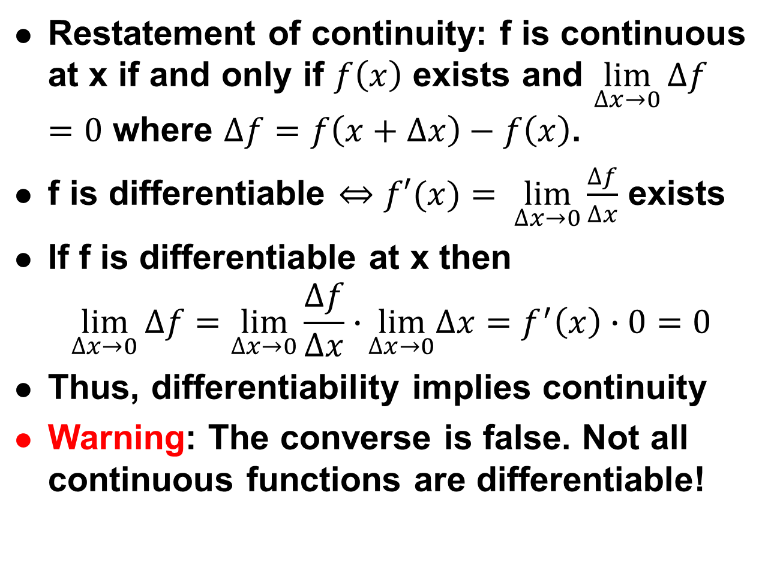
Differentiable Implies Continuous
Restatement of continuity: f is continuous at x if and only if $f\left(x\right)$ exists and $\lim_{∆x→0}{∆f}=0$ where $∆f=f\left(x+∆x\right)−f\left(x\right)$.
f is differentiable $⇔$ $f′(x)= \lim_{∆x→0}{\frac{∆f}{∆x}}$ exists
If f is differentiable at x then
$$\lim_{∆x→0}{∆f}=\lim_{∆x→0}{\frac{∆f}{∆x}∙}\lim_{∆x→0}∆x=f^{′}\left(x\right)∙0=0$$
Thus, differentiability implies continuity
Warning: The converse is false. Not all continuous functions are differentiable!

Slide 22
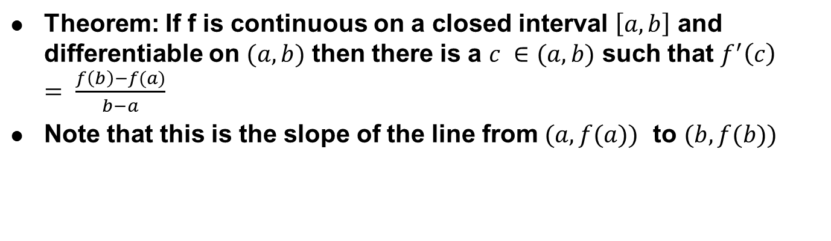
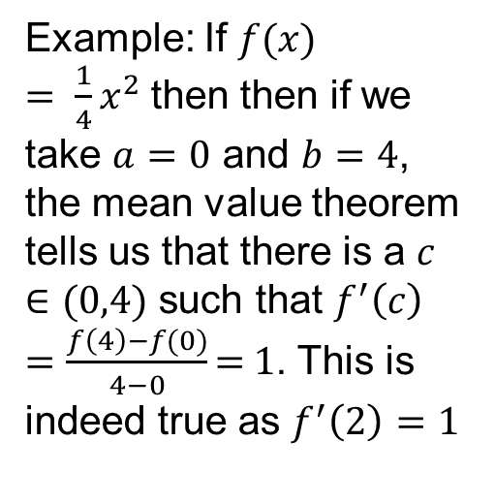
The Mean Value Theorem
Theorem: If f is continuous on a closed interval $\left[a,b\right]$ and differentiable on $(a,b)$ then there is a $c ∈(a,b)$ such that $f^{′}\left(c\right)= \frac{f\left(b\right)−f(a)}{b−a}$
Note that this is the slope of the line from $(a,f(a))$ to $(b,f(b))$
4
Example: If $f(x) = \frac{1}{4}x^{2}$then then if we take $a=0$ and $b=4$, the mean value theorem tells us that there is a $c ∈(0,4)$ such that $f^{′}\left(c\right)=\frac{f\left(4\right)−f(0)}{4−0}\text{= }\text{1}$. This is indeed true as $f^{′}\left(2\right)=1$
3
2
1
f(x)
0
-1
-2
-3
-4
-4
-3
-2
-1
0
1
2
3
4
x

Slide 23
Average and Instantaneous Speed
The idea behind the derivative is that if we look at smaller and smaller intervals (taking the limit as the length of the interval approaches 0), the average speed over the interval approaches the instantaneous speed.
The mean value theorem says that over any interval, there is some point where the instantaneous speed matches the average speed.
Warning: These statements are only true for differentiable position functions. Otherwise, weird stuff can happen.

Slide 24
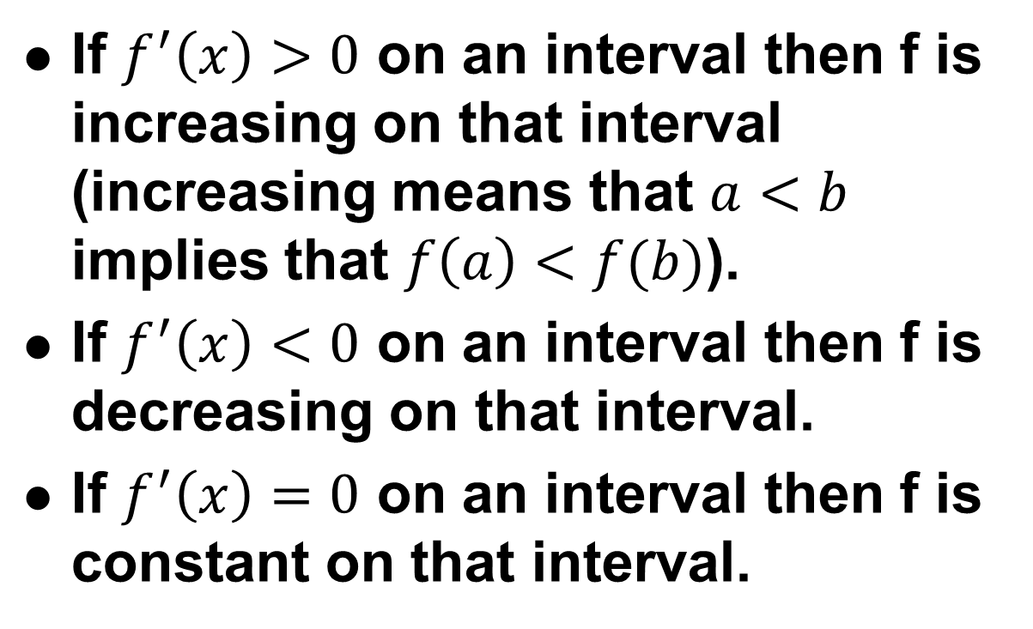
Other Consequences of the Mean Value Theorem
If $f^{′}\left(x\right)>0$ on an interval then f is increasing on that interval (increasing means that $a<b$ implies that $f\left(a\right)<f(b)$).
If $f^{′}\left(x\right)<0$ on an interval then f is decreasing on that interval.
If $f^{′}\left(x\right)=0$ on an interval then f is constant on that interval.

